Slide 1
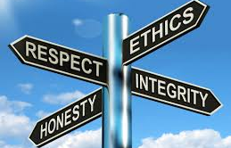
Academic Integrity: Intellectual Honesty

Slide 2
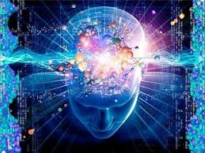
The Human Intellect

Slide 3
About intellectual power
The intellect is a faculty of the soul
It is a power for abstraction, judgement and reasoning.
It belongs only to man and spiritual beings.
It’s object is truth.
It is exercise in freedom and choice

Slide 4
Honesty and Integrity
Honesty is a virtue that disposes one to always strive to assert what is true.
Integrity is the virtue of living in accordance with strong moral principles.
Integrity is the quality of being honest with oneself, with others and with the society.

Slide 5
Intellectual Honesty
Intellectual honesty is honesty in the acquisition, analysis, and transmission of ideas.
A person is being intellectually honest when he or she, knowing the truth, states that truth.

Slide 6
THE VIRTUES OF THE RESEARCHER
Meticulousness in Research
Accuracy in Research
Fidelity in writing the project
Constructive criticism
Clarity in the mode of argument

Slide 7
METICULOUSNESS IN RESEARCH
Attention to details
Constancy
Perseverance
Time management
Order

Slide 8
ACCURACY AND FIDELITY IN CARRYING OUT A WRITING PROJECT.
Truthfulness
Precision
Completeness

Slide 9
CONSTRUCTIVE CRITICISM
Healthy critical spirit: do not limit yourself to receiving data without examining them carefully.
Be sure of the truth of what you have written.
Prudence and modesty in criticism.

Slide 10
CLARITY IN THE WAY OF ARGUING
Transparency
Elegance
Concision
Humility
Modesty

Slide 11
➢ Opposes ambiguity or duplicity.
➢ Continuous readings and corrections: they are not one waste of time
➢ Knowing how to bring out the truth back (veritatis splendor) ‘with style.’
Transparency
Elegance

Slide 12
Concise
Sobriety in style: avoiding the verbosity of adjectives.
Sobriety in content: avoiding unnecessary repetitions or unnecessary clarifications.

Slide 13
Humility and Modesty
Do not think you have discovered the wheel. Scholars have been around 2500 years!
Very seldom someone makes a revolutionary contribution

Slide 14
Intellectual Dishonesty
Intellectual dishonesty is the advocacy of a position known to be false. An argument which is misused to advance an agenda.
Intellectual dishonesty is a vice that undermines good scholarship.

Slide 15
Examples of intellectual dishonesty
Twisting facts to favor a benefactor (researches on over-population, euthanasia, abortion etc.)
Teachers who exert pressure on their students to accept their views that are wrong.
A judge who gives in to political pressure and delivers wrong judgement.

Slide 16
Contd…
A journalist or media practitioner who knowingly falsifies information and broadcasts such to the public.
Arguing for a viewpoint you yourself disbelieve or using logical fallacies to push your point.
Deliberately ignoring facts and arguments that would undermine your position. (willful ignorance)

Slide 17
Intellectual Property(IP)
Intellectual property refers to works or creations brought forth by one’s intellectual effort for which one is designated and protected by law as the sole owner.
Examples: Books, music, discoveries, ideas, inventions, symbols etc.

Slide 18
Intellectual Property Rights (IPRs)
Those rights which intellectual property owners enjoy over their works is known as intellectual property rights.
Examples: Patent rights, Copyrights, trademarks, Industrial design rights.

Slide 19
Patent Rights
Patent rights is a set of rights exclusive to an inventor or patentee, granted him/her by the state for a limited period of time in exchange for the public disclosure and use of his invention.

Slide 20
Conditions for Patent Rights
Novelty of invention: Must be new and unknown before patent application.
Non-Obvious: Must have adequate distance beyond the state of art.
Usefulness: Must have commendable utility value for the public.

Slide 21
Trademark
A trademark is a sign capable of distinguishing the goods or services of one enterprise from those of other enterprises.
Trademarks date back to ancient times when craftsmen used to put their signature or "mark" on their products.

Slide 22


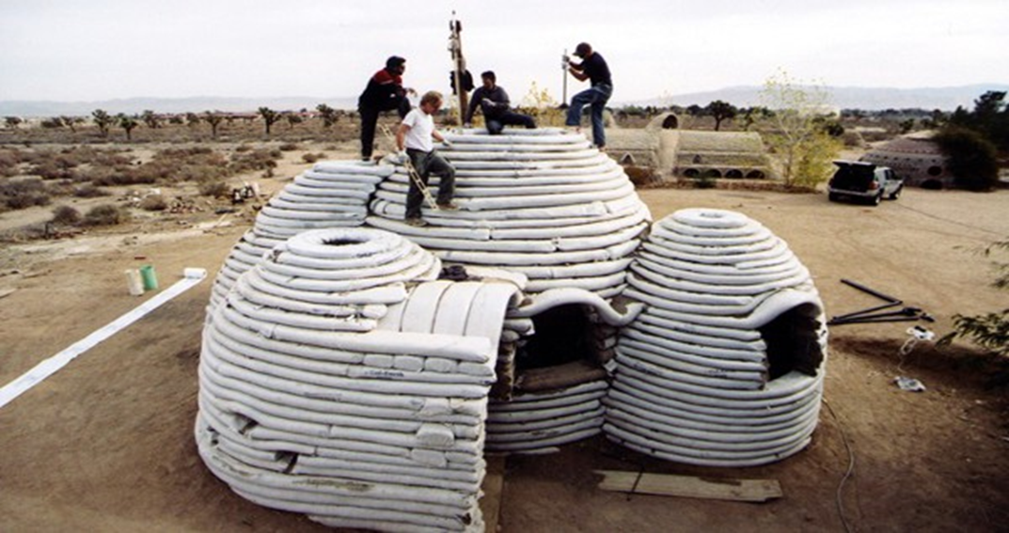
Images of trademark

Slide 23
Copyright
Copyright is a legal right that grants the creator of an original work exclusive rights for its use and distribution for a limited time, usually 50-100 years after his/her death.
The right could be shared by multiple authors –right holders.
NB: Nigerian Copyright Commission.
http://www.nigerialaw.org/CopyrightAct.htm

Slide 24
Copyright works
(a) literary works;
(b) musical works;
(c) artistic works;
(d) cinematograph works;
(e) sound recording; and
(f) broadcasts

Slide 25
Copyright Duration in Nigeria
Literary, musical or artistic works other than photographs is 70 years after the death of the author.
Broadcasts is 50 years after the year of first broadcast.
Cinematograph films and photographs is 50 years after the year the work was publicized.
Sound recordings is 50 years after the year of first recording.

Slide 26
Self plagiarism
Self-plagiarism is the re-use of substantial, indistinguishable and nearly identical portions of one’s own work without acknowledging the original work.

Slide 27
Plagiarism is considered a serious offense in the academic community. To plagiarize means to take the ideas, words, or work of another and claim them as your own. Another word for this is concept is stealing.
Most students and professionals do not intentionally try to commit plagiarism. One example of intentional plagiarism would be to purchase a paper off the internet and present the entire document as your own. Another example would be to copy and paste an entire section of a textbook or journal article into your own work and claim that you wrote the entire document yourself. These are two blatant examples of cheating, and you should know that these behaviors constitute academic and professional dishonesty.

Slide 28
However, while most people are not guilty of intentional plagiarism, it is unfortunately easy to fall into the category of the "accidental plagiarist." There may be no intent to cheat or steal, but the end result is still considered plagiarism. The key to avoiding plagiarism is to carefully document your resources in order to provide the proper attribution to other authors in your work.
http://lib.dmu.edu/su/ethicaldoc/plagiarism

Slide 29


Plagiarism and PAU Policy on Plagiarism
Plagiarism is an example of intellectual dishonesty.
The policy only covers plagiarism with regard to academic work: essays,
dissertations,
theses,
research reports,
projects and
assignments, whether oral, written or in other media, and whether it is submitted to PAU or to any other institution or medium.

Slide 30
Examples of Academic Dishonesty
Copying from another student during an exam
Presenting a paper copied from a file or purchase and presenting it as original work
Faking the results of a laboratory experiment or work
writing a laboratory report without performing the lab
activity/experiment
Asking for examination content or answers from another student
Using material from another researcher’s/student’s paper without giving him/her credit
“Sitting for” or taking an exam for another student
Allowing another student to look at one’s answer sheet during a test or exam
Claiming authorship or participation in a group paper or presentation when no contribution was made

Slide 31
Disciplinary Measures
Disciplinary Measures – Students
Marginal plagiarism: Less than two paragraphs, or data of similar importance is cancellation of the specific paper.
Significant plagiarism: More than two paragraphs, but less than 20% of the total work = Suspension for two weeks.
Substantial plagiarism (more than 20% of the total work) in Masters dissertation or doctoral thesis = Expulsion.
Substantial plagiarism (more than 20% of the total work) in any other work = Suspension for one year.
If a student had already received his/her degree and it is discovered that there is plagiarism, his certificate can be revoked.

